Slide 1
Timesheet Portal Guidelines

Slide 2







Index
About Collabera Timesheet Portal
Portal Login Process
How to fill Timesheet on Collabera Portal ?
How to Claim Expense on Collabera Portal ?
How to Claim Shift Allowance on Collabera Portal ?
Help
Please click from the options given above to start with.

Slide 3


About Collabera Timesheet Portal
11
Collabera Timesheet Portal is designed to collect your Timesheets and for the submission of your Shift and Expense Claims.
Details of Days / Hours, of working at Client / Project, is basic important for Collabera, for measuring your attendance, it’s linked with your monthly salary disbursement.
Collabera Timesheet details should be filled on weekly basis which should be in line with your Manager’s approved Timesheet.
For your smooth billing, please support Collabera by submitting your Timesheet weekly with respect to your billing cycle, for any information relating to your billing cycle please reach out to APAC Timesheet at APAC.Timesheet@collabera.com
2
3
4
5

Slide 4
Login to Collabera Portal using the credentials provided to you by Collabera Operations Team.
Portal Login Process
11
2
Collabera Portal link
https://hcv.collabera.com/COL_Ops/Collabera/CL.aspx
Click here to open
3
4
Click here: How to recover your password?
5
Click here: How to change your password?
How to Fill Timesheet on Collabera Portal?

Slide 5
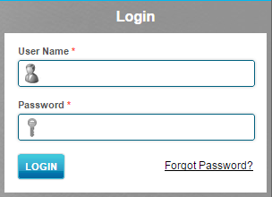
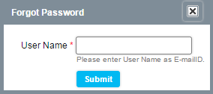
How to recover your Password ?
Steps:
1. Click on the ‘Forget Password’ option given on the portal
2. A popup will appear, In Username, please enter your personal Email ID which is registered with Collabera.
(Incase, if you’ve forgotten your email ID, please drop a mail to APAC.TimeSheet@collabera.com with your Collabera Employee code)
3. By clicking on Submit, you will receive your portal password at your email ID.
Portal Login Process
11
1
2
3
4
5

Slide 6
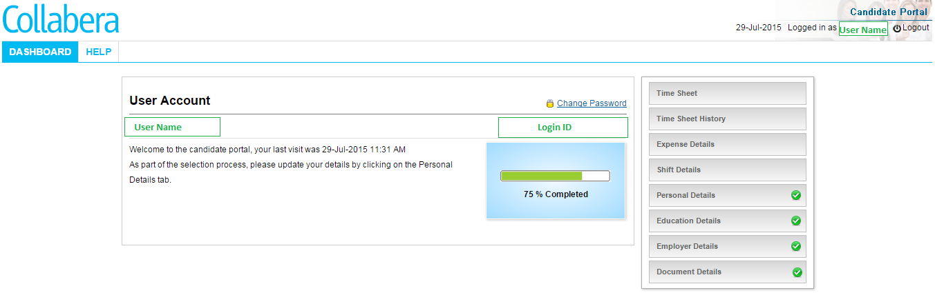
Portal Login Process
11
How to change Password?
Once you’ve successfully login, you will be able to see the below portal screen.
2
3
4
5

Slide 7

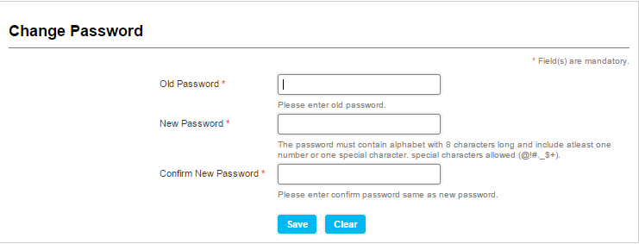
Steps:
Click on Change Password option given on the portal screen
The below screen will appear, please follow the guidelines given on the screen to change your password.
Portal Login Process
11
2
3
4
5

Slide 8
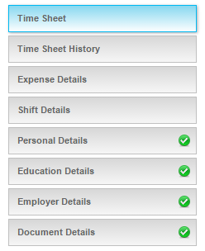
Click on the TimeSheet option given on the start screen.
How to fill Timesheet on Collabera Portal ?
11
2
Please note: Collabera Portal Timesheet should match with your Client Approved Timesheet.
3
4
5

Slide 9
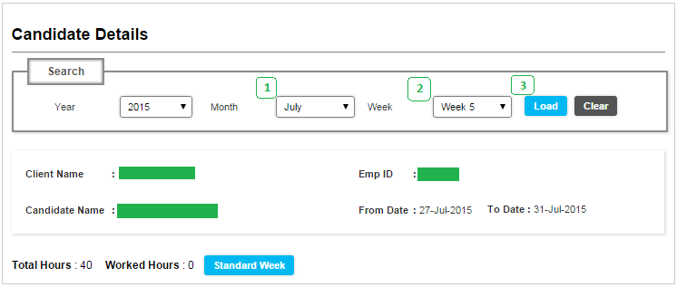
On Clicking Timesheet option, the below screen will appear.
Steps:
How to fill Timesheet on Collabera Portal ?
11
2
1. Select Month
2. Select Week
3. Click on Load
3
4
5

Slide 10
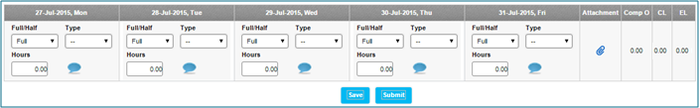
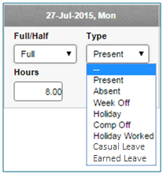
The below Timesheet screen will be loaded with blank values, also user will be able to see their Leave Balance in the Timesheet screen.
How to fill Timesheet on Collabera Portal ?
11
2
3
4
Please note that a user is required to mark status for each day (i.e. present / absent / leave), also one is required to enter hours for that particular day in the Timesheet.
5

Slide 11
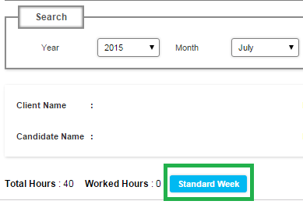
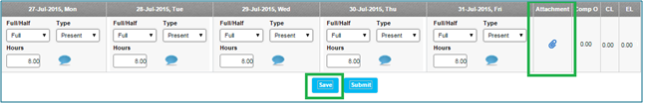
Clicking on this option, will load the default values in the Timesheet (Present Status / Default Hours) for all the days of the week.
A user is required to attach the Approved Timesheet along with the Manager’s Approval. If a user is sending Timesheet Month Wise to APAC Timesheet Team, then they are required to attach the whole month Timesheet at the last week of the Month with their manager’s approval.
Save / Submit: Click on Save then Submit, once the Weekly Timesheet is entered.
How to fill Timesheet on Collabera Portal ?
11
Standard Week:
2
Attachment:
3
4
5

Slide 12
How to fill Timesheet on Collabera Portal ?
11
Please note:
Marking Leaves / Absent
In the Type Dropdown, you will be able to see options to mark a Day as Leave (SL / EL / CL) (if applicable) or as Absent, incase if Leave options are not visible to you or your Leave Balance is not accurate please inform the APAC Timesheet Team to help you out.
2
3
4
5

Slide 13

How to fill Timesheet on Collabera Portal ?
11
Please note:
Regarding Attachment : You are required to attach the Approved Timesheet File which you’re sending to APAC Timesheet with your Manager’s Approval.
Please note that If you are not sending any Timesheet File to APAC Timesheet, kindly ignore the Attachment option.
2
3
4
5

Slide 14
How to fill Timesheet on Collabera Portal ?
11
Please note:
Keep on updating your Timesheet on weekly basis, this will be helpful to run your payroll smoothly.
Click on ‘Submit’ only after filling / verifying the Timesheet.
If the Timesheet is Submitted, then it will be locked, and it won’t facilitate anymore to edit / change the same.
2
3
4
5
Next: How to Submit Timesheet on Collabera Portal?

Slide 15

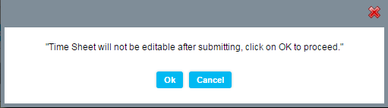
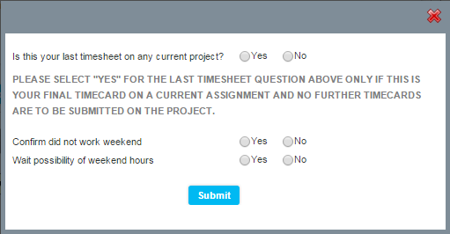
How to fill Timesheet on Collabera Portal ?
11
How to submit Timesheet on Collabera Portal ?
Click Submit on the Timesheet screen
Click on OK
Fill the details as required
Click on Submit
Submitted Successfully popup will appear!
2
3
Please note:
Select Yes in the ‘Confirm did not work weekend’, if you haven’t worked on weekend,
Select Yes in ‘Wait Possibility of weekend hours’, if you are likely going to work on weekends in future.
4
5
Next: How to view Timesheet Summary on Collabera Portal?

Slide 16
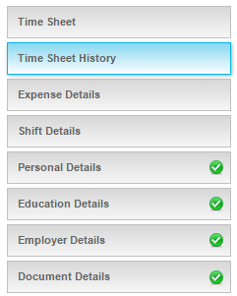
How to view Timesheet Summary on Collabera Portal ?
11
2
Click on Timesheet History option given on the Start Screen
3
4
5

Slide 17
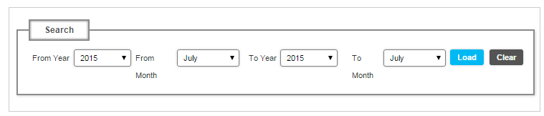
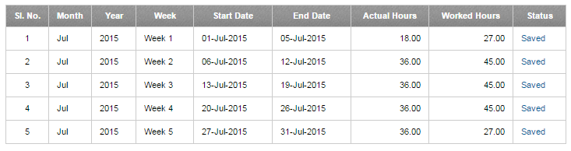
How to view Timesheet Summary on Collabera Portal ?
11
The below screen will appear,
Select the Duration for which you need to view Timesheet Status (From Month / To Month), Click on Load.
2
3
The below like summary of your Timesheet will be appear.
4
5
Next: How to claim Expense on Collabera Portal?

Slide 18
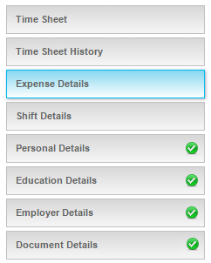
How to Claim Expense on Collabera Portal ?
11
2
Click on Expense Details option given on the Start Screen
3
Please note:
Confirm with your ER POC to check if you are eligible to claim Expense or not.
It’s mandatory to attach your Manager’s approval while claiming Expenses.
For any query relating to expenses please reach out to your ER POC.
4
5

Slide 19

How to Claim Expense on Collabera Portal ?
11
2
The below screen will appear, click on the ‘Click here to add expense details’ option to start with.
3
A blank record will be created to add your expenses.
4
Please note: For claiming each expenses, a resource is required to create an individual record, in case if there are more expenses under one head, then a resource is required to ask for ‘Expense Claiming Sheet’ from their ER POC, which is required to be attached as a proof along with their Manager’s approval.
No expenses without manager’s approval will be considered as valid.
5

Slide 20
How to Claim Expense on Collabera Portal ?
11
Steps:
2
Select type of expense from the Title Dropdown
Enter Start Date of the Expense
Enter End Date of the Expense
Enter Amount
Please put the description of the expense
Attach your Manager’s approval as a Proof
Click on Update
3
4
Once updated, a user will be able to see the expense added as below:
5
Next: How to claim Shift Expense on Collabera Portal?

Slide 21
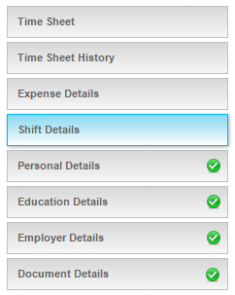
How to Claim Shift Allowance on Collabera Portal ?
11
2
3
Click on Shift Details option given on the Start Screen
Please note:
Confirm with your ER POC to check if you are eligible to claim Shift Allowance or not.
It’s mandatory to attach your Manager’s approval while claiming Shift Allowance.
For any query relating to Shift Allowance please reach out to your ER POC.
3
5

Slide 22

How to Claim Shift Allowance on Collabera Portal ?
11
2
The below screen will appear, click on the ‘Click here to add Shift Allowance’ option to start with.
3
A blank record will be created to add your Shift Allowance.
3
5

Slide 23
How to Claim Shift Allowance on Collabera Portal ?
11
Steps:
2
Select Shift Allowance from the Title Dropdown
Enter Start Date
Enter End Date
Enter Amount
Please put the description of the Shift Claim
Attach your Manager’s approval as a Proof
Click on Update
3
3
Once updated, a user will be able to see the Shift Allowance added as below:
5

Slide 24
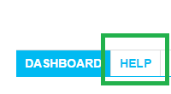
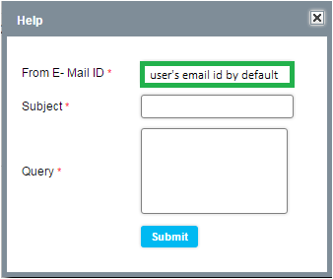
Help
O
2
For any query you can write at the ‘Help’ option given on the portal, the mail will be sent to APAC Timesheet or you can manually send a mail at APAC.Timesheet@collabera.com
We would be glad to help you out!
O
O
Thank You
O

